Slide 1


AirAware – Smart Air Quality Prediction System
Intern: Sharmika Gangadharan
Mentor: Shakthi Gopalakrishnan
Organization: Infosys Springboard

Slide 2


The Challenge We're Solving
Rising Pollution Crisis
Air pollution is escalating rapidly across Indian cities, with millions exposed to hazardous air quality daily. Current systems only display live AQI readings without forecasting future trends.
The Gap: Users lack early warnings before pollution reaches harmful levels, making it impossible to plan ahead or take preventive action.

Slide 3
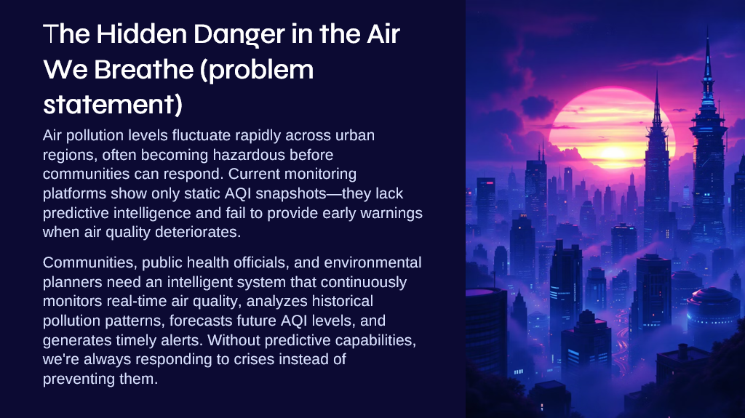

Slide 4
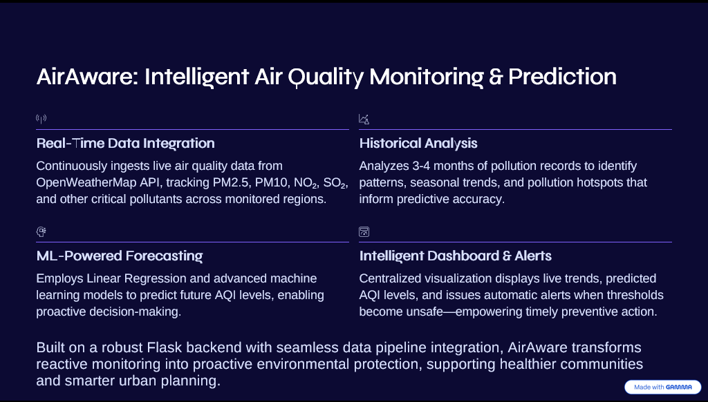

Slide 5




AirAware: A Comprehensive Solution
Real-Time Monitoring
ML-Based Forecasting
Live AQI tracking using OpenWeatherMap Air Pollution API across all Indian states
Machine learning algorithms predict future pollution trends and patterns
Interactive Dashboard
Smart Alerts
Visual analytics for PM2.5, PM10, NO₂, SO₂, CO, and O₃ pollutants
Automated notifications when air quality reaches harmful levels
AirAware integrates backend infrastructure, database management, and machine learning pipelines to create a complete environmental monitoring ecosystem that supports live tracking, forecasting, and visualization.

Slide 6





System Architecture Overview
Frontend UI Layer
HTML/CSS/JavaScript dashboard with Chart.js visualizations for interactive AQI display and real-time graphs
Flask Backend
API routes connecting ML model, dataset, and external APIs for seamless data flow and processing
Dataset Layer
Auto-generated CSV with pollutant metrics covering 36 Indian states and union territories
ML Prediction Engine
Linear regression model analyzing historical patterns to forecast future AQI trends
External API Integration
OpenWeatherMap API providing real-time pollutant values and weather conditions

Slide 7
Project Architecture & Structure
airaware/
├── app.py
├── generate_air_quality_csv.py
├── data/│
└── air_quality.csv
├── templates/│
├── landing.html│
└── dashboard.html
└── requirements.txt
app.py
Flask backend server
generate_air_quality_csv.py
Live dataset generator
Templates
Landing & dashboard UI
Design Philosophy: This modular structure ensures clean code organization, component reusability, and system scalability. Each layer operates independently while maintaining seamless integration.
Data
Clean CSV dataset

Slide 8


Comprehensive Dataset Design
Location Data
Air Quality Metrics
Data Processing
State and city names
Monitoring stations
AQI and category classification
Missing value handling
Latitude/longitude coordinates
PM2.5, PM10 particulate matter
Normalization techniques
Timestamp information
NO₂, SO₂, CO, O₃ levels
Outlier removal
Time-series formatting
Temperature readings
Data Source: OpenWeatherMap Air Pollution API covering all Indian states and union territories, with 3-4 months of historical data (expandable for deeper analysis)

Slide 9


Slide 10
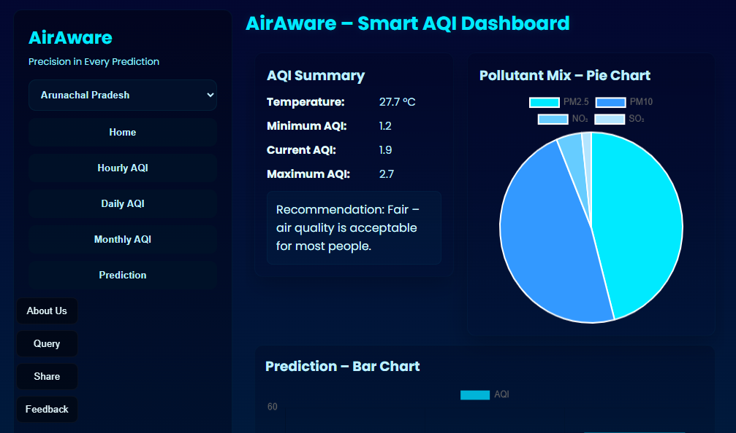

Slide 11

Machine Learning Implementation
1
Data Collection
Gather historical AQI values and pollutant metrics
2
Model Training
Train linear regression on time-series patterns
3
Prediction
Forecast AQI for next N years
4
Validation
Compare actual vs predicted values
5
Visualization
Display trend graphs on dashboard
Why Linear Regression?
Time-series optimization: Excellent for forecasting pollution trends over time
Performance: Lightweight and fast computation
Interpretability: Easy to visualize and understand predictions
Future Enhancements: Random Forest, Support Vector Machines, and LSTM networks for deep learning-based predictions

Slide 12
Backend API Architecture
GET /api/state/<name>
GET /api/Apredict
CSV Generator Script
Parameters: state, years
Returns:
Returns:
Generates:
AQI summary statistics
Forecasted AQI values
air_quality.csv dataset
Pollutant composition mix
Prediction trend line
Uses OpenWeatherMap API
Hourly and monthly time series
Year-wise prediction table
Updates with latest data
Current weather conditions
Each endpoint is optimized for performance and delivers structured JSON responses for seamless frontend integration.

Slide 13

Results & Impact
Real-Time Monitoring Achieved
Successfully deployed AQI tracking across all Indian states with live updates and comprehensive pollutant analysis
Predictive Forecasting
Machine learning model accurately forecasts future air quality trends, enabling proactive decision-making
Enhanced Visualization
Interactive dashboard with multiple chart types provides clear insights into
pollution patterns and trends
Actionable Alerts
Automated notification system alerts users when air quality reaches harmful levels, protecting public health
Conclusion: AirAware successfully demonstrates how Machine Learning, APIs, and Full-Stack Development can be combined to build a powerful environmental monitoring system. This solution can be extended to IoT sensors, mobile applications, and smart-city integrations for broader impact.

